Slide 1
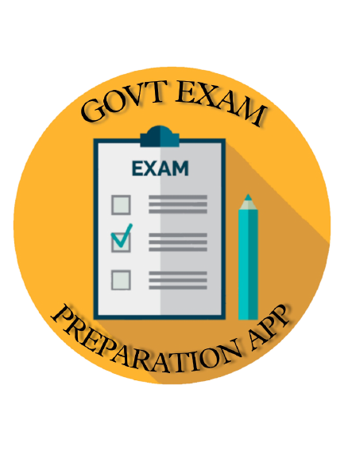
Government Exam Preparation App
A basic quizzer app for candidates appearing various Government Exams.
Submitted By:
Tejas Narendra Sakpal - 42208
Omkar Dilip More - 42225

Slide 2
Introduction
“ Govt Quiz application ” is a collection of different quizzes like General knowledge, Reasoning, English & Mathematics.
User can access only one quiz at a time.
There will be a limited number of questions and for each question correct answer will be shown after attempting the question.

Slide 3
Synopsis
Technologies:
Software Requirements:
XML
JAVA
Android Studio

Slide 4
Problem Definition
“Our aim is to develop a Govt Quiz Preparation application for the users in which a user can attempt number of quiz related to his/her choice”
Firstly, we have to make interface for Home Page, Category Page Question Attempting Forum, Result Page.
Many Android Applications do not have a single platform for quizzes related to General knowledge, Reasoning, English & Mathematics, etc.
We have to develop a application which can resolve all the problems.

Slide 5
The Project “Govt Quizzer Application” can be used for educational purpose by many aspirants, school and also by coaching institute.
It can also be used by a person for his/her self improvement and knowledge test.
A user can gain knowledge by attempting the quiz in various fields like General knowledge, Reasoning, English &
Mathematics, etc.
Need for
Computerised System

Slide 6
Proposed System
Unlike the websites where you need to make account for every quiz you want to attempt, using this application based on android, you just have to start the application and then you will get access to all quizzes from it. The proposed system is an application for the Android platform mobiles will help in improving the knowledge and accuracy.
The proposed system will be developed for Android mobiles only because the market share of Android is more than other operating systems.

Slide 7
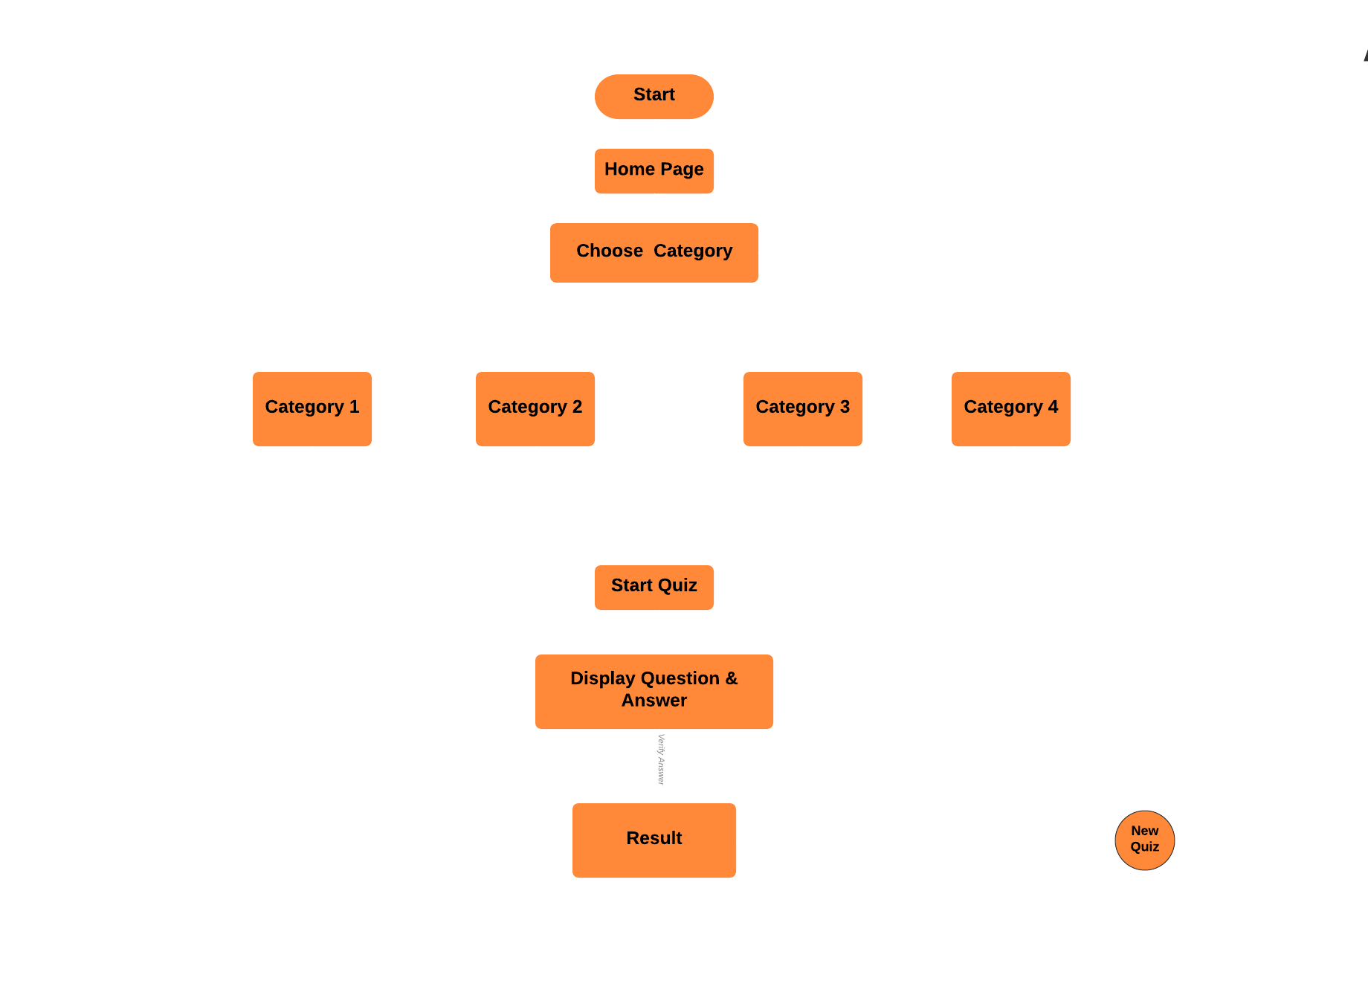
Data Flow Diagram

Slide 8
Solution Domain
In this application firstly we have included the Home Page
Then the user can choose any of the quiz of his/her choice.
User can start attaining the quiz.
User can see his/her answers are right or wrong and can also see the answer of each.
After completion of the quiz user will get credit score for each of its correct answers.
Then again user can start the new quiz with another category or he can close the application.

Slide 9
Expected Outcome
01
02
03
04
User can start new quiz again.
User can attempt any type of quiz from the given list.
Result of the quiz attempted by the user will be displayed.
User can know his/her level of knowledge in the current world.

Slide 10
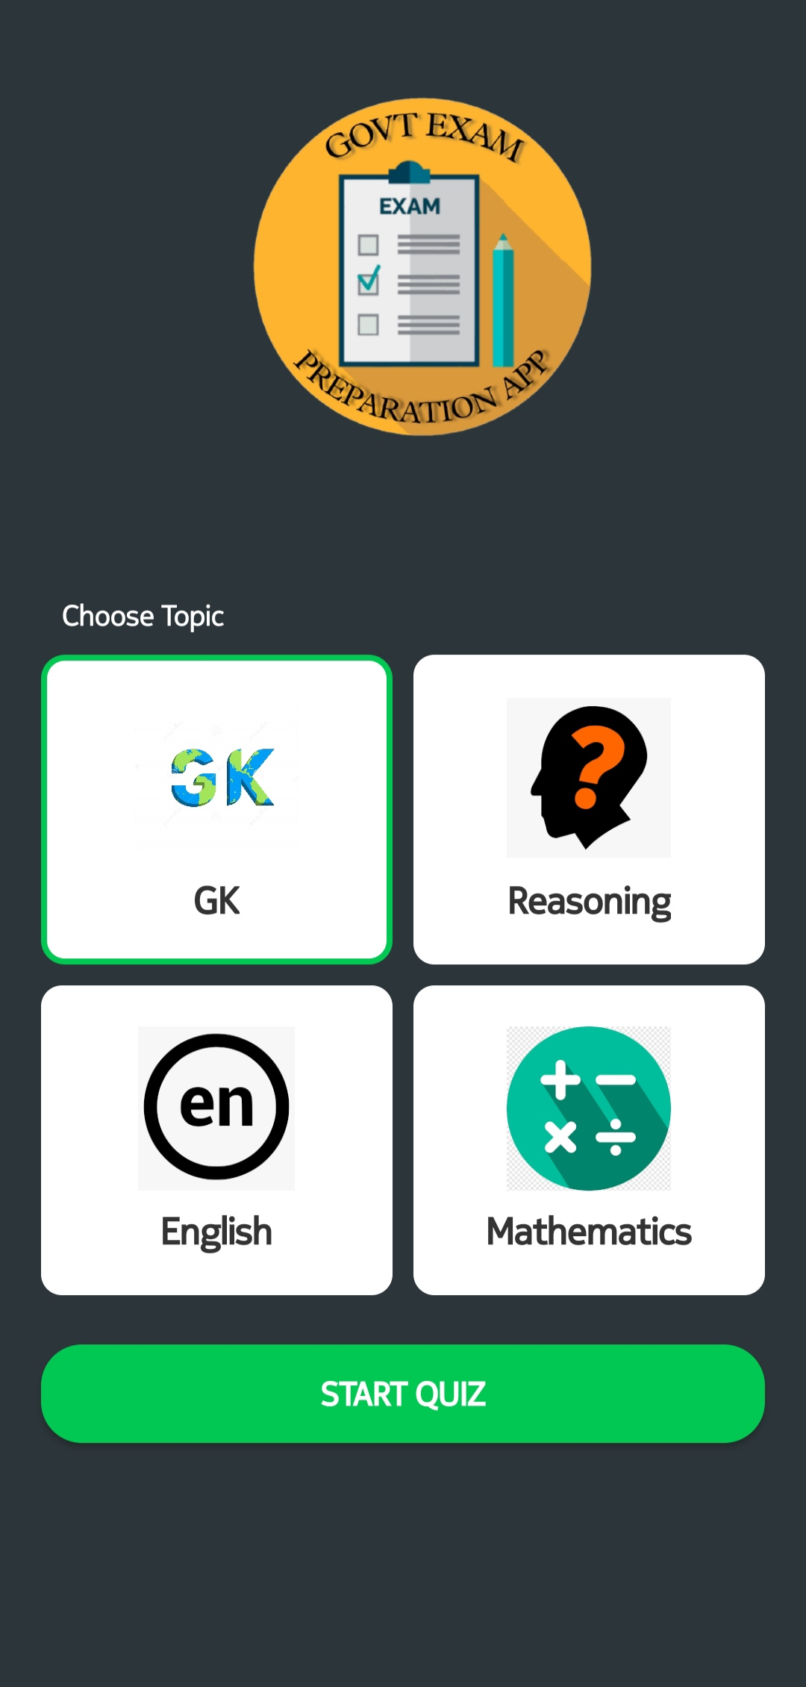
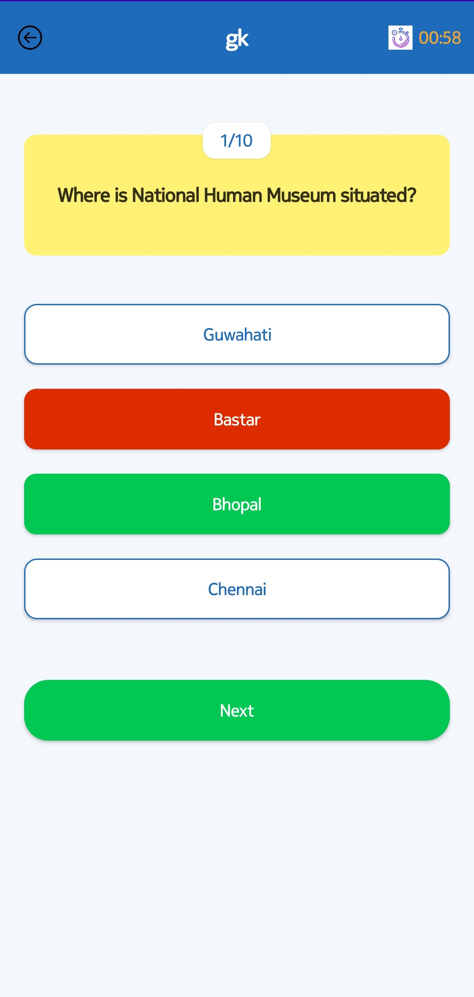
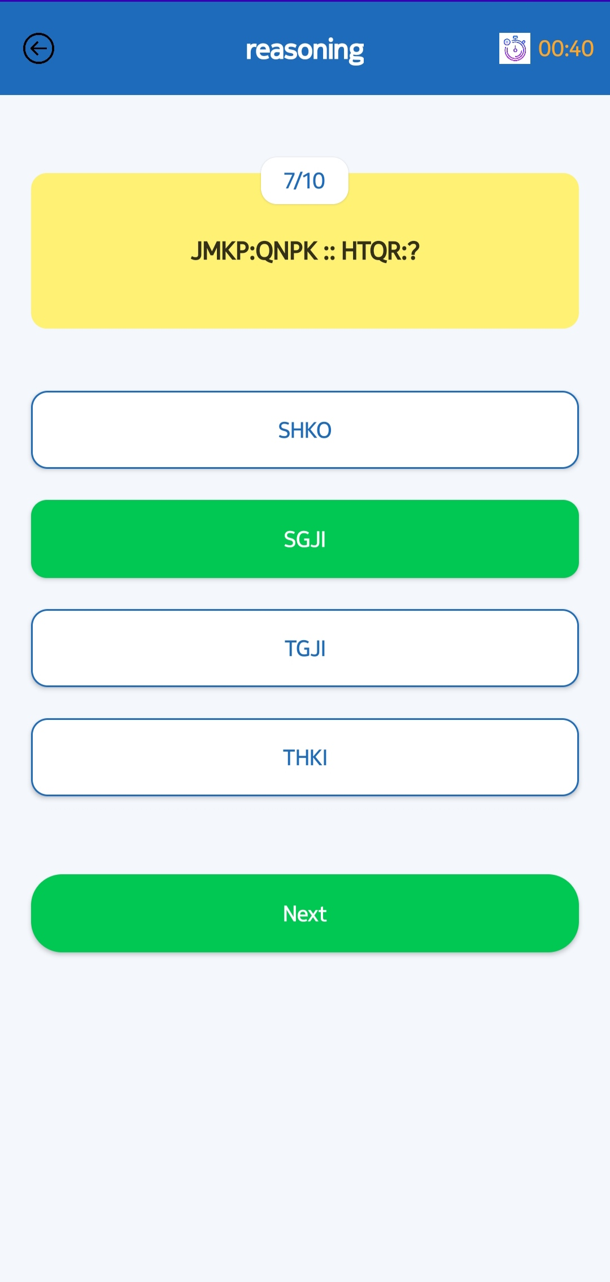
Screen Design

Slide 11
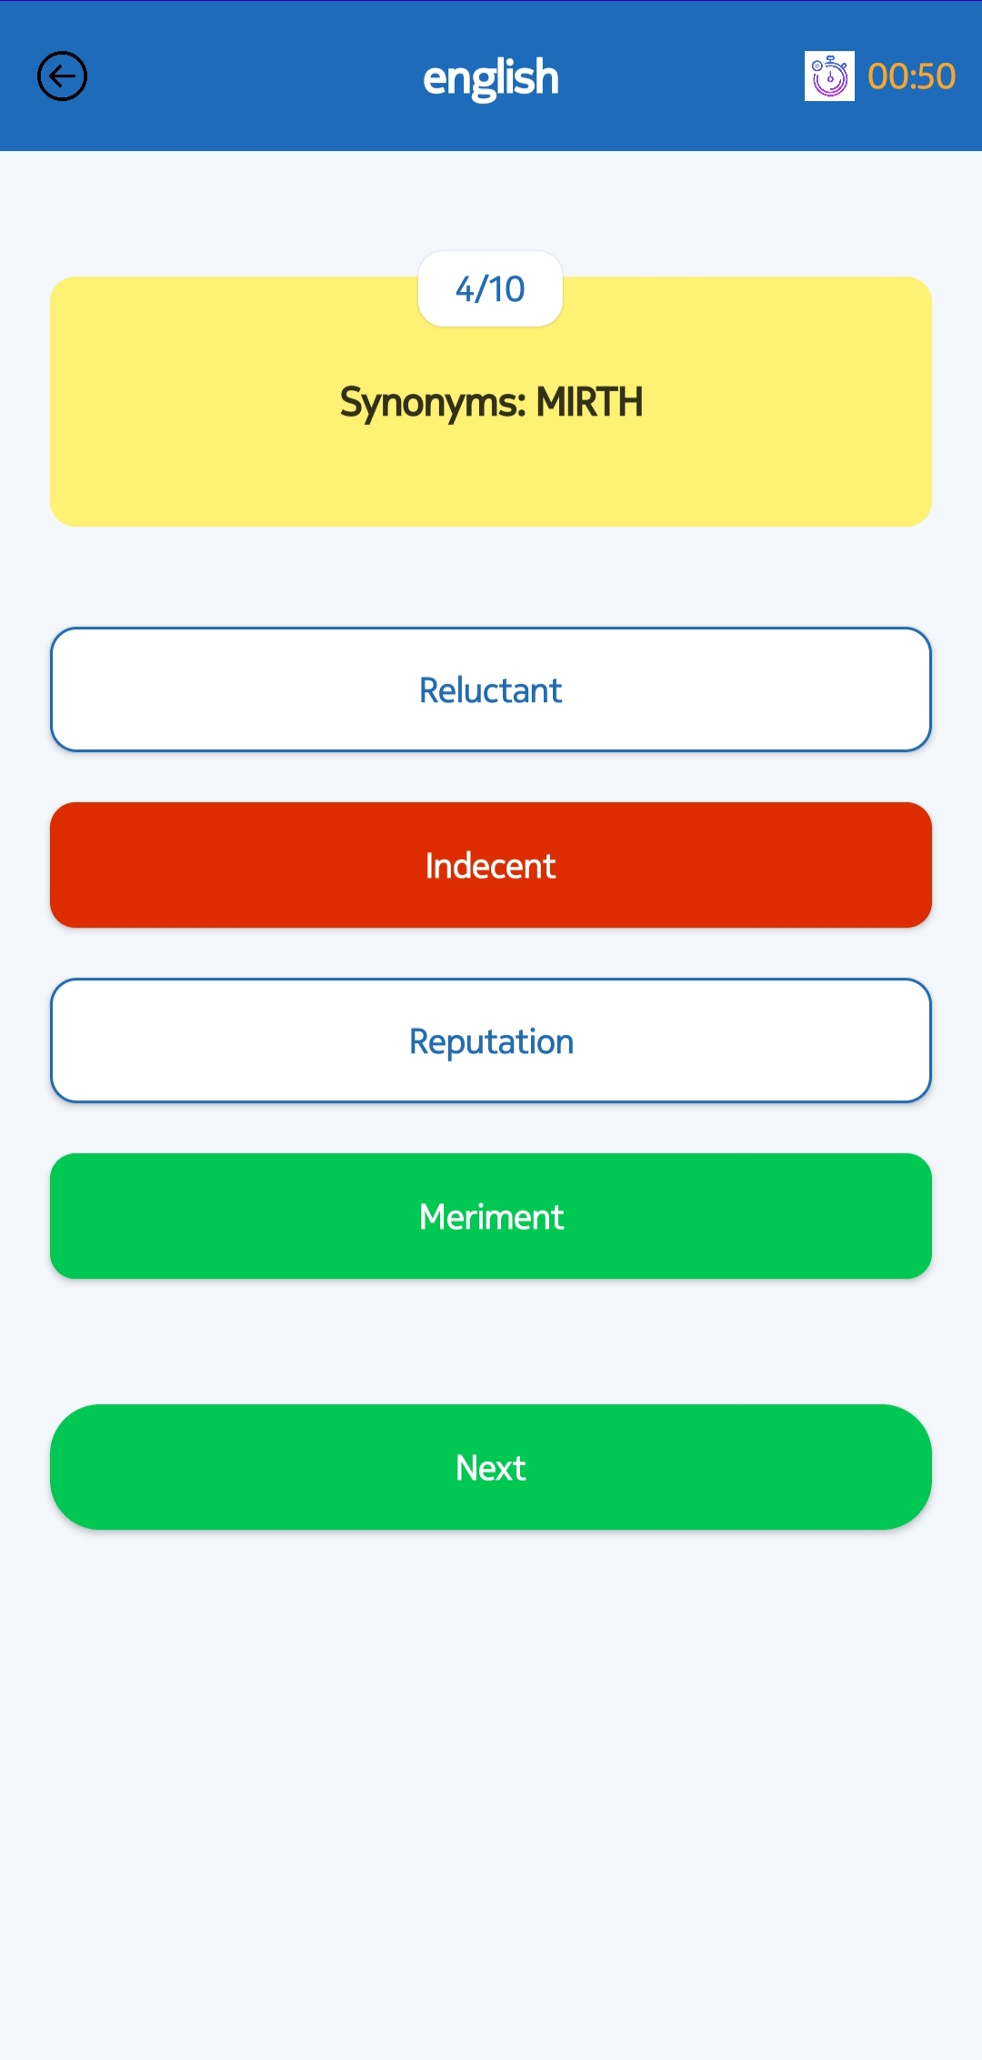
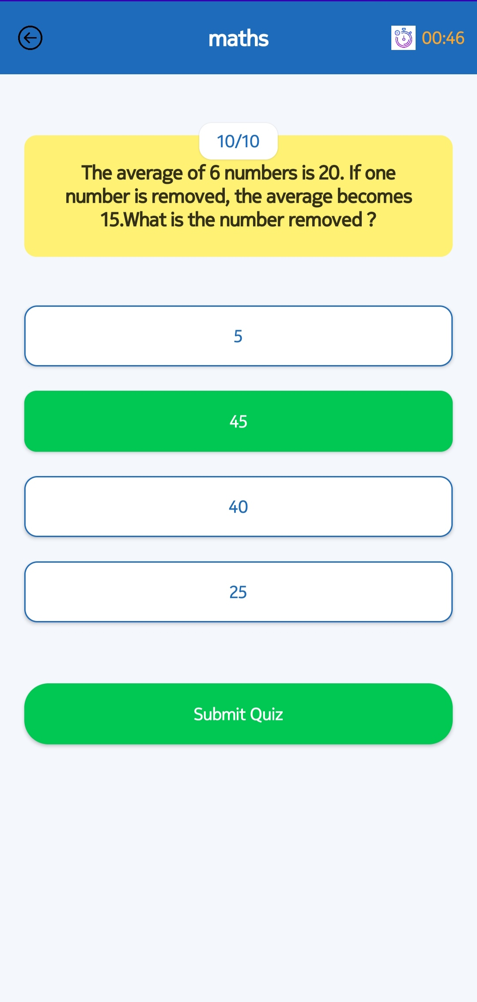
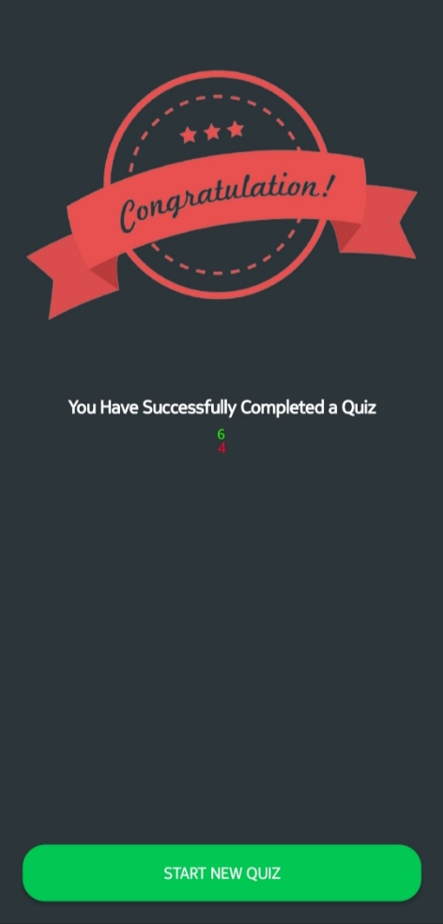
Screen Design

